Slide 1

Unit 2

Slide 2
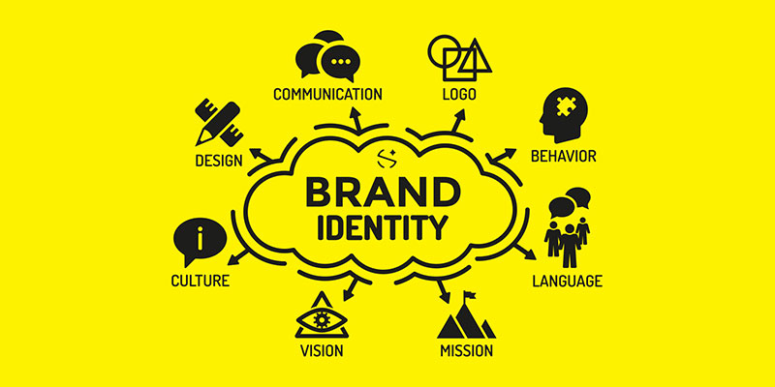

Slide 3

WHAT IS A BRAND IDENTITY SYSTEM (BIS)?
A Brand Identity System is a collection of elements which work together to create unified, consistent and flexible brand assets that communicate the brand value to the target audience effectively.
BRAND MARK
COLOR PALETTE
TYPOGRAPHY
VISUAL BRAND EXTENSIONS
BRAND TONE

Slide 4

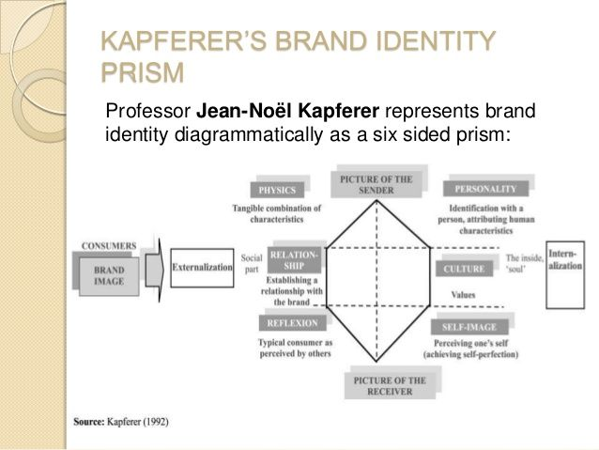

Slide 5
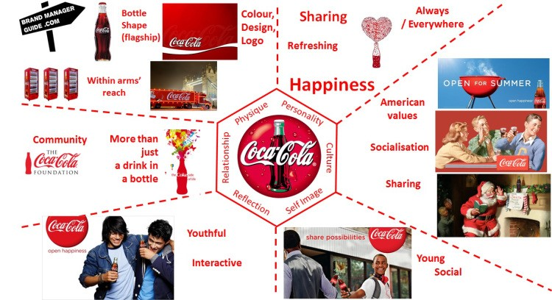

Slide 6
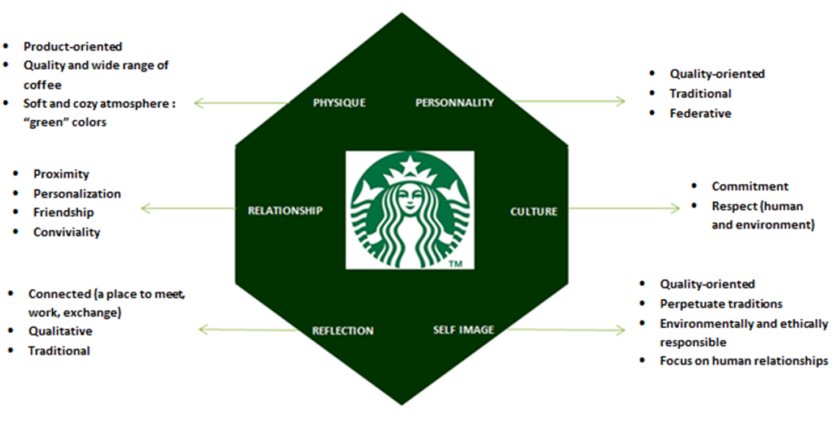

Slide 7
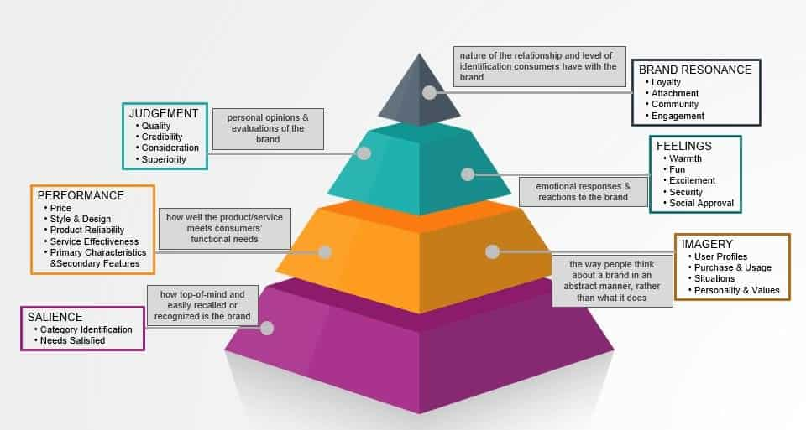
Brand Resonance Pyramid
Keller’s Customer-Based Brand Equity (CBBE) model

Slide 8

BRAND EQUITY
Brand equity refers to a value premium that a company generates from a product with a recognizable name when compared to a generic equivalent.

Slide 9
APPROACHES TO MEASURING BRAND EQUITY
Economical (O data)
Emotional (X data)

Slide 10
WAYS TO MEASURE BRAND EQUITY
Brand Evaluation
Brand Strength
Brand Awareness
Brand Relevance
Output Metrics
Financial Data
Competitive Metrics

Slide 11
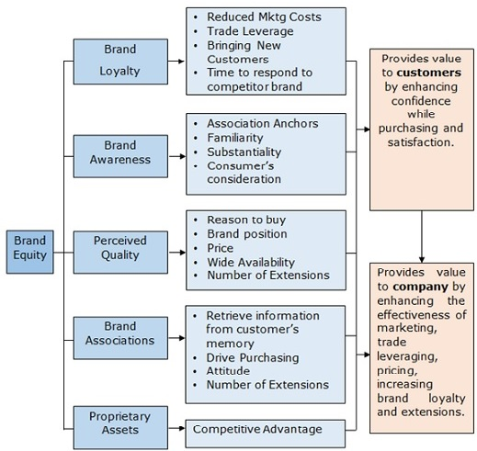
AAKER’S BRAND EQUITY MODEL

Slide 12
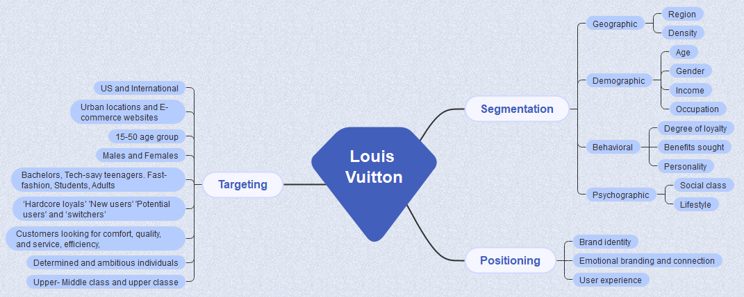



Slide 13
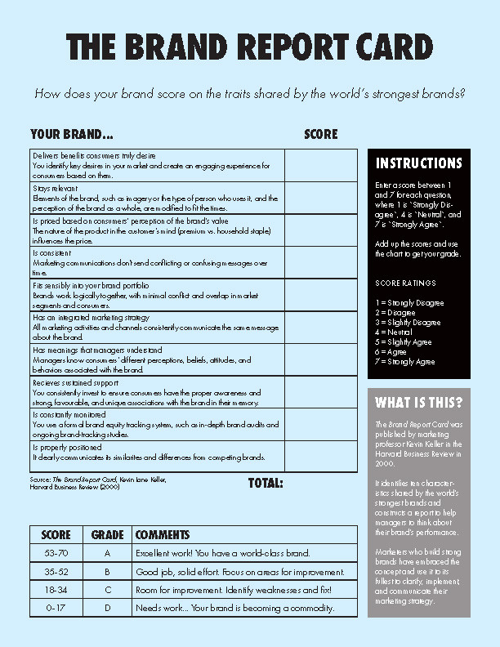
The Brand Report Card
A Brand report card is defined as an evaluation system that brands or companies use to periodically audit the strengths and weaknesses of a brand on a few specific and relevant characteristics and comparing those with some of the world’s strongest brands in the same niche.

Slide 14

Attributes of a Brand Report Card
Is the brand offering that customers truly desire
Does the brand stay relevant
Is the pricing strategy based on consumers’ perceptions of value
Is the brand properly positioned

Slide 15

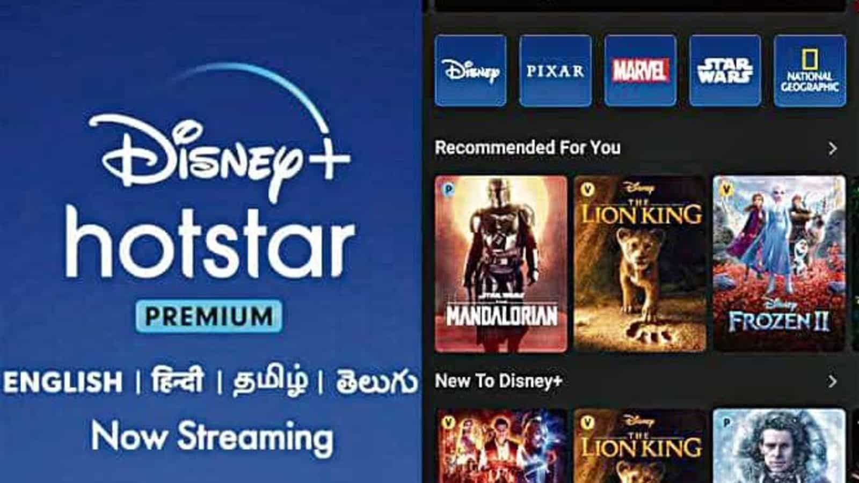




Slide 16

Disney’s Brand Experience
Make customers happy
Increase brand loyalty
Increase customer retention
Spread positive word of mouth
Reduce marketing costs in the long run
Help in crises management

